Slide 1
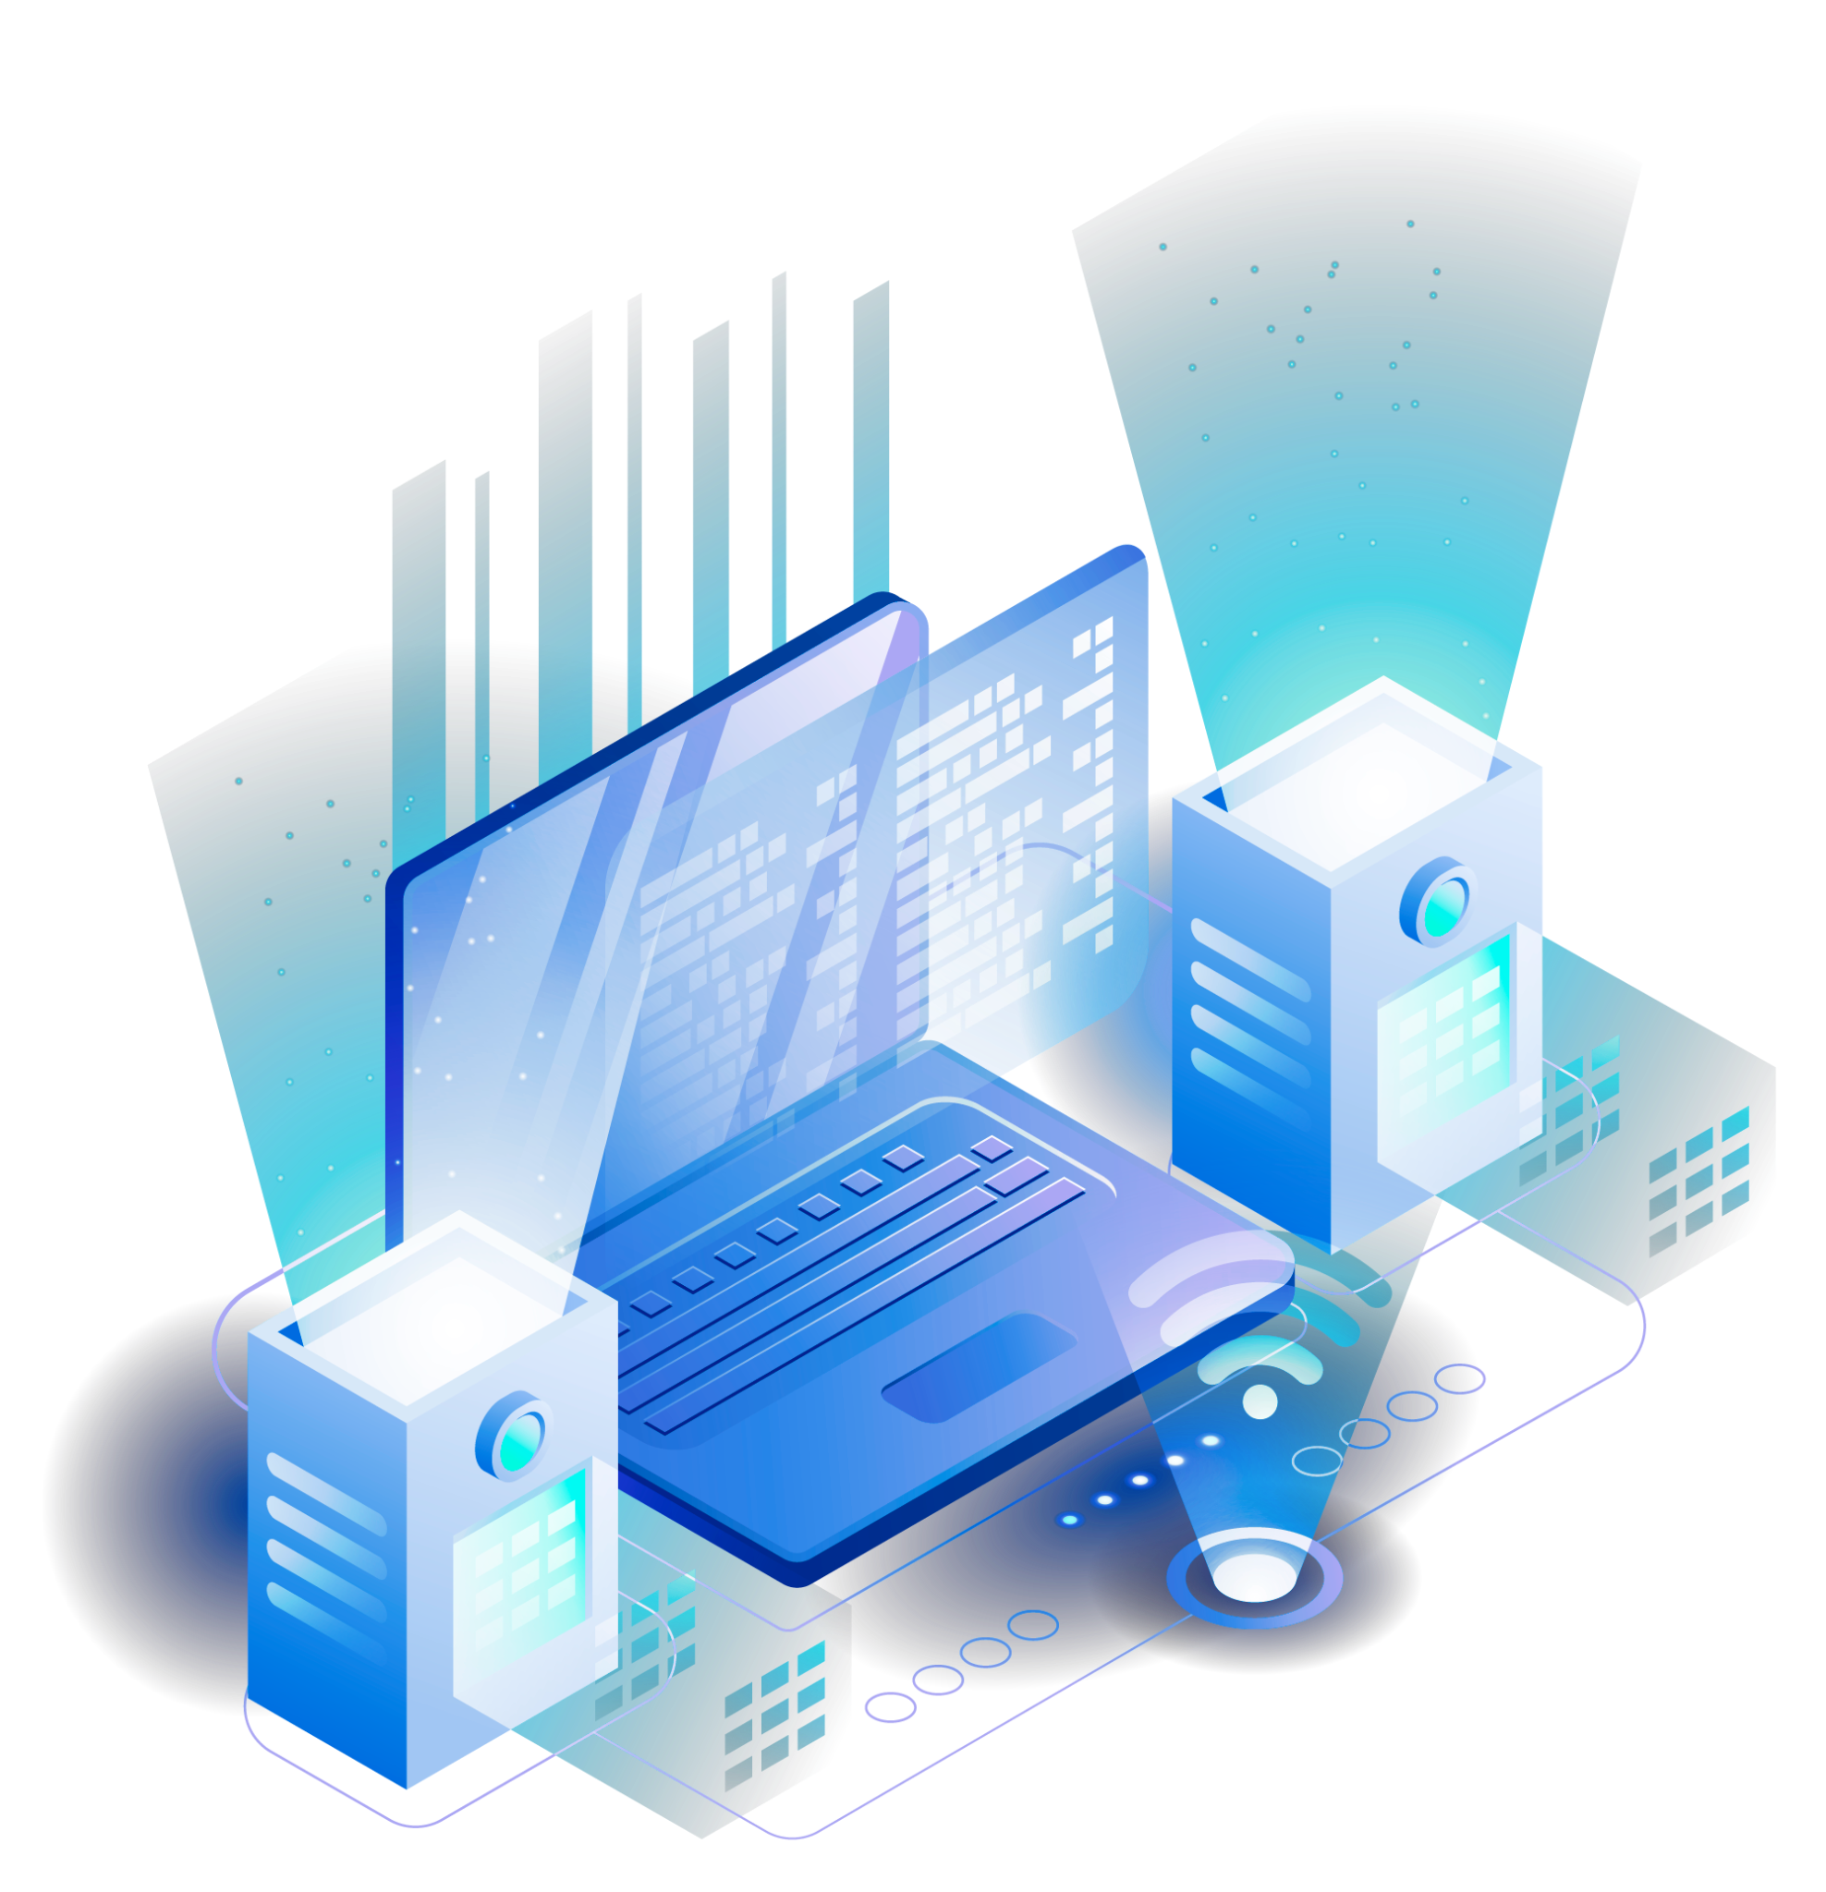
EGE322 Iot System Project Project Presentation
Development of Smart Home Automation
Armando ()
Sanjeev (221325c)

Slide 2
Table of contents
01
04
07
02
05
08
03
06
Introduction
Hardware overview
Problems, Encountered & Solution
Overview of Project
Software overview
Reference & Conclusion
Our prototype
Outcome, Demo of project

Slide 3
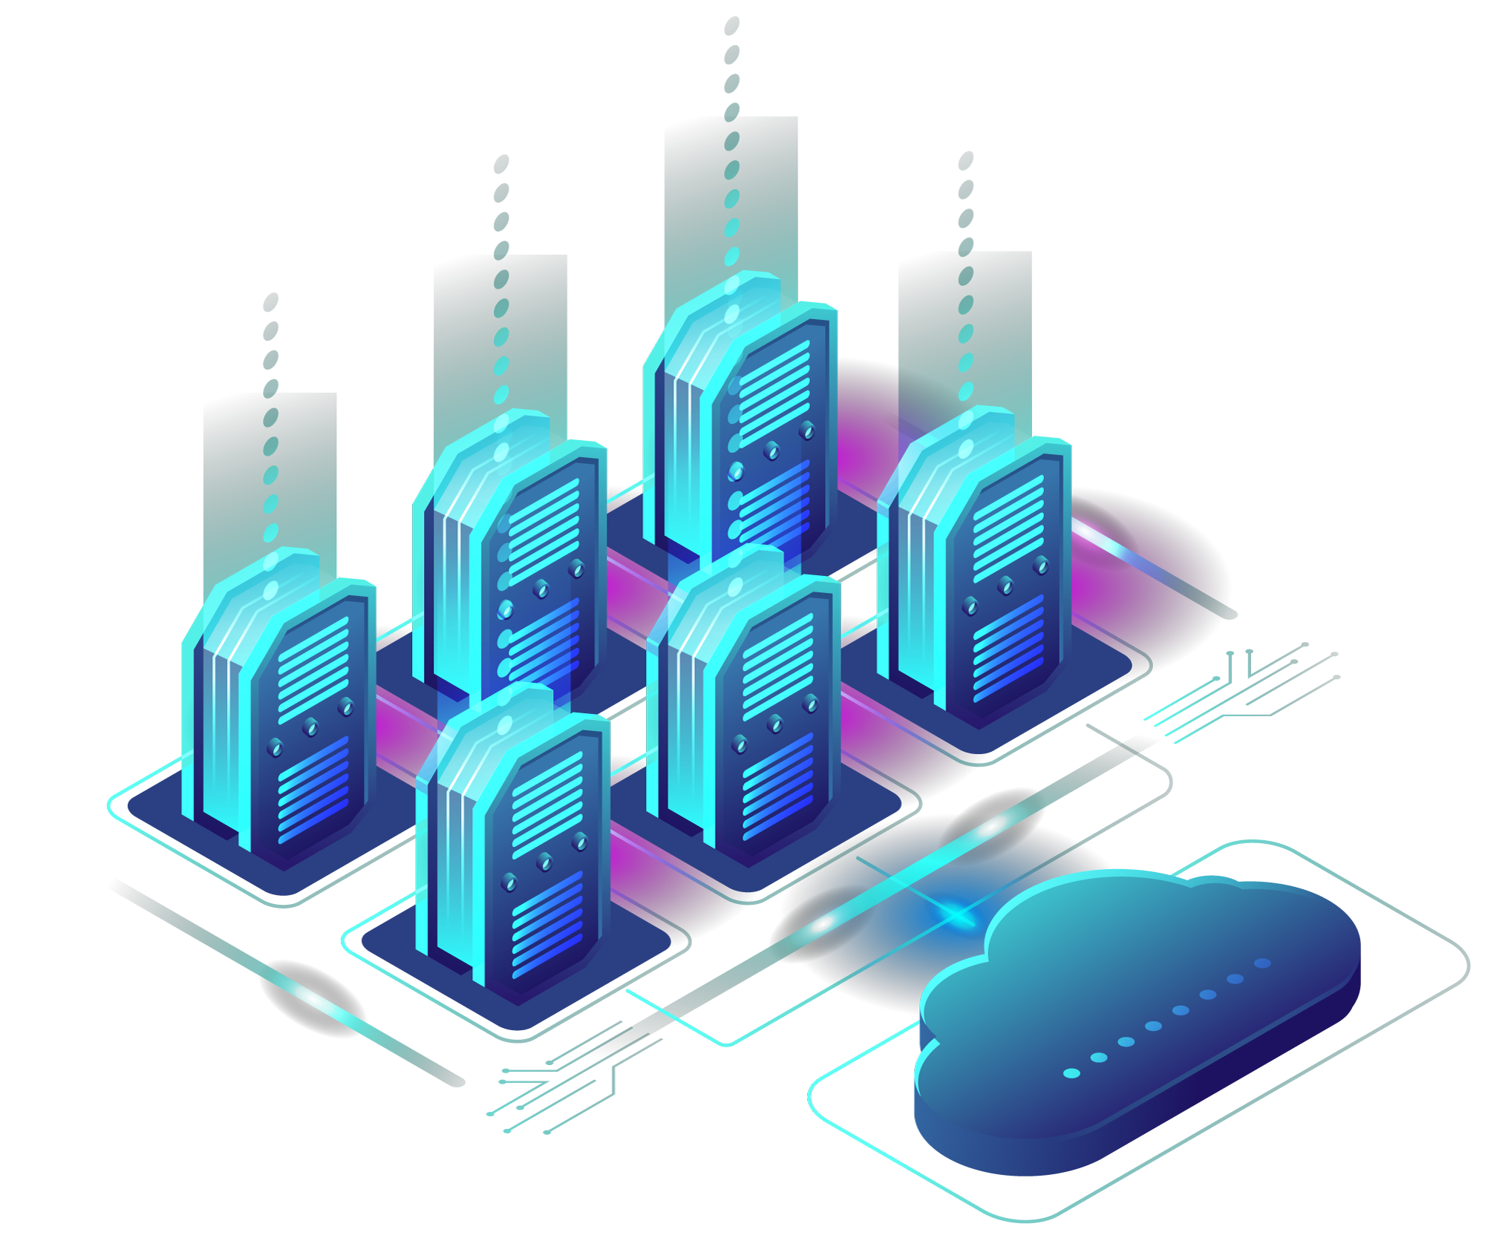
01
Introduction

Slide 4
Theme
Preventive Healthcare Measures for Malnutrition

Slide 5
Problem
Despite the increasing awareness of the importance of nutrition, modern lifestyles often lead to imbalanced diets, contributing to malnutrition and related health issues. Traditional methods of diet tracking and management are time-consuming and often lack accuracy, hindering proactive healthcare.

Slide 6

Objective
The primary objective of the smart cabinet is to enhance preventive healthcare measures for malnutrition by providing comprehensive visibility into an individual's dietary habits and health data. This system aims to support better diagnosis and prognosis by offering doctors detailed and accurate information about a patient's daily health and lifestyle. Additionally, it seeks to promote healthy eating habits through personalised recommendations and automated inventory management.
Integration with Healthcare Providers
The smart cabinet's ability to gather and send detailed nutrient consumption reports and health data to doctors bridges the gap between daily habits and medical advice. This integration supports preventive healthcare by enabling doctors to offer more precise recommendations based on accurate, real-time data.

Slide 7
Sub-Objective
Automate Inventory Management
AI-powered Image Recognition: Automatically identifies and catalogs food items.
Live Feed and User Interface: Provides a real-time view of the cabinet's contents through an app or web dashboard.
Impact: Streamlines grocery management, reduces food waste and ensures the family always has fresh and nutritious options.
Quality of Life (QOL) Changes
Promote Healthy Eating: Personalized recipe suggestions and tailored recommendations help the family make healthier food choices.
Track and Analyze Eating Habits: Provides insights into dietary patterns, helping users make informed decisions about their diet.
Impact: Enhances the overall quality of life by making it easier to maintain a healthy diet, ultimately leading to better health outcomes.

Slide 8
02
Overview of Project

Slide 9
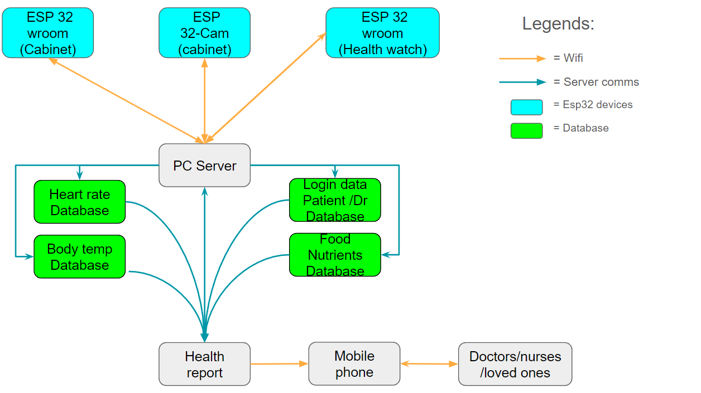
System Block Diagram

Slide 10
Project Description
The IoT-enabled smart cabinet is a novel solution designed to address the challenges of maintaining a healthy diet. By combining AI, IoT, and sensor technology, the cabinet provides real-time insights into food consumption, nutritional intake, and overall health. It offers personalized recommendations, automates inventory management, and integrates with healthcare providers to facilitate preventive healthcare.

Slide 11
Project Objective
Enhance preventive healthcare measures for malnutrition through comprehensive dietary monitoring and analysis.
Provide personalized nutrition recommendations to promote healthy eating habits.
Automate inventory management to reduce food waste and ensure access to fresh, nutritious food.
Integrate with healthcare providers to enable better diagnosis and treatment.

Slide 12
Features
1. Habit Tracker
ESP32 Cam(core): Captures images of food items placed in the cabinet, enabling AI-powered image recognition to identify and catalogue these items.
Weight Sensor(core): Tracks the amount of food consumed, providing data on eating habits and portion control.
Role: By tracking what and how much food is consumed, the habit tracker helps identify nutritional patterns and deficiencies. This data is crucial for providing personalized health recommendations and alerts.

Slide 13
Features
2. Nutrition Facts and Craving Detector
Craving Detector: Analyzes the lack of vitamins in the blood, alerting users to potential nutrient deficiencies.
Nutrient Deficit Alert(core): Sends notifications when the diet lacks essential nutrients.
Role: These features ensure that the family maintains a balanced diet, addressing any deficiencies promptly to prevent malnutrition and related health issues.

Slide 14
Features
3. Health Data Gatherer
Sensors (Temperature, Humidity, Heart Rate)(core): Collect vital health data from individuals.
Logistics: Tracks and logs the use of items from the cabinet, maintaining an accurate inventory.
Role: Gathering comprehensive health data allows for better understanding and monitoring of each family member's health, aiding doctors in making more informed diagnoses and recommendations.

Slide 15
Extra Features
Auto Locks : Restricts access to pest and other things allowing the food inside to have a longer shelf life
Phone Access and Knock Knock Feature: Allows users to see inside the cabinet via touch or phone, enhancing convenience and preserving the internal environment.
Role: These features ensure that the family follows healthy eating habits and schedules, reducing the risk of overeating or consuming unhealthy snacks.

Slide 16
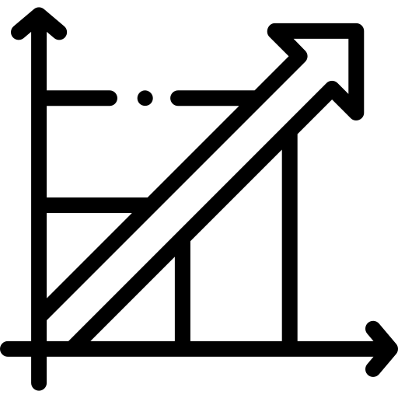


Our System Uniqueness
Proactive Health Management
Predicts potential health issues based on your eating habits and provides solutions to prevent them.
UVP
Seamless Integration
health data is shared directly with your doctor, allowing for better, more informed care.
AI-Driven Personalization
The cabinet learns your preferences and adapts to your needs, providing a customized health and nutrition experience.

Slide 17
03
Our prototype

Slide 18
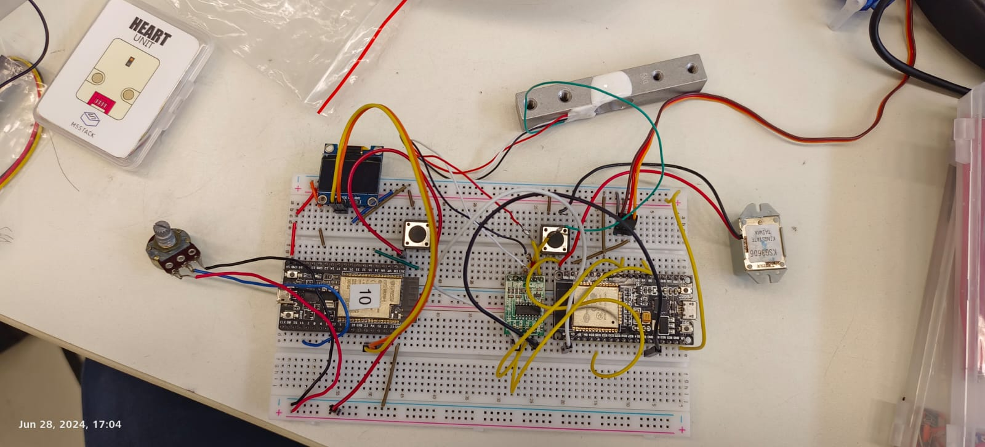
First Proof of concept circuitry

Slide 19
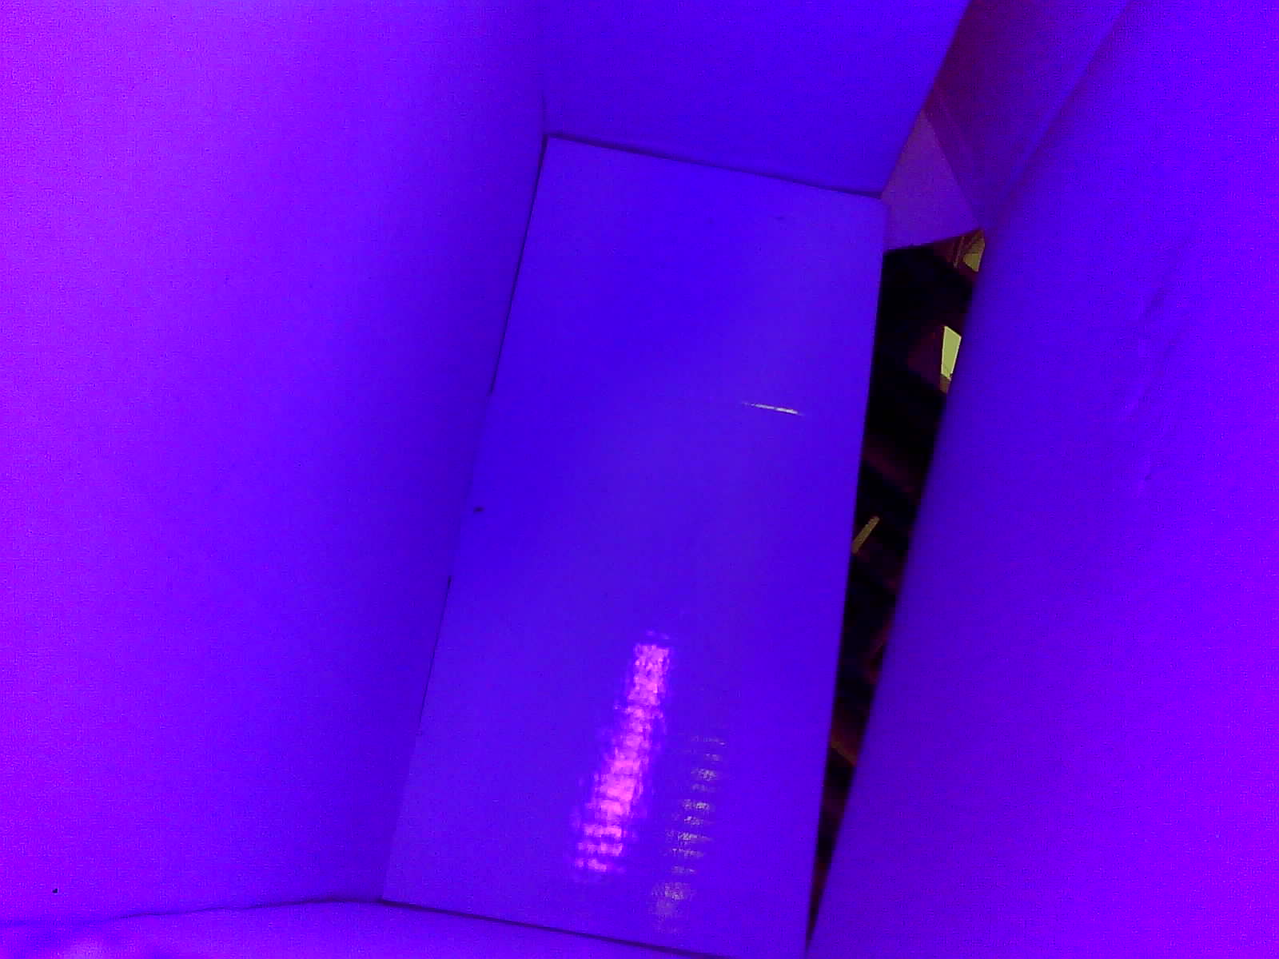
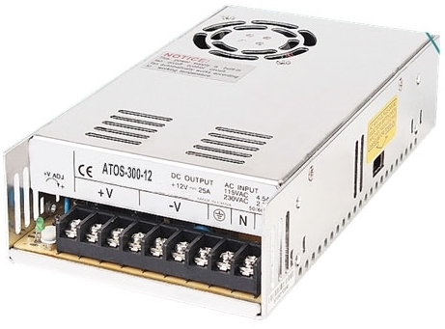
Prototype 1 (Cabinet)
Used a shoebox:
cut out a hole to mount the esp32 cam
Initially used UV light strips
The Light strips are powered by a 12V power supply
Decided against this because:
space constraint
visually unappealing

Slide 20
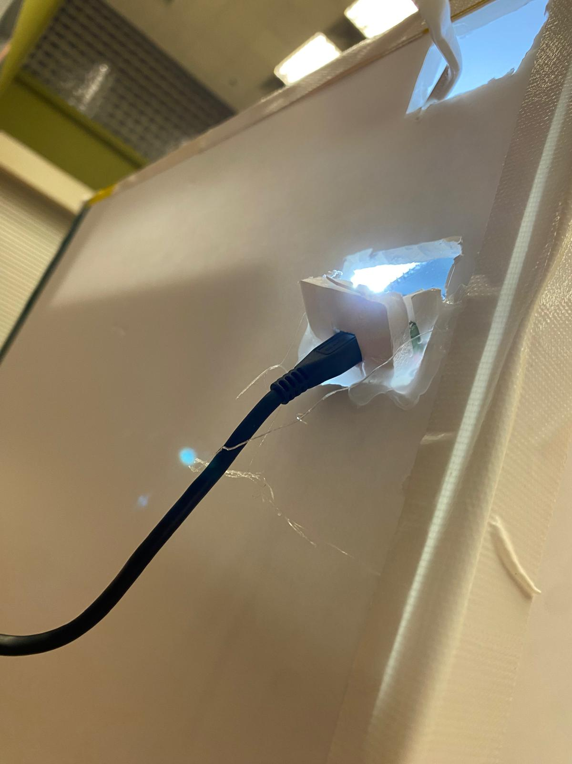
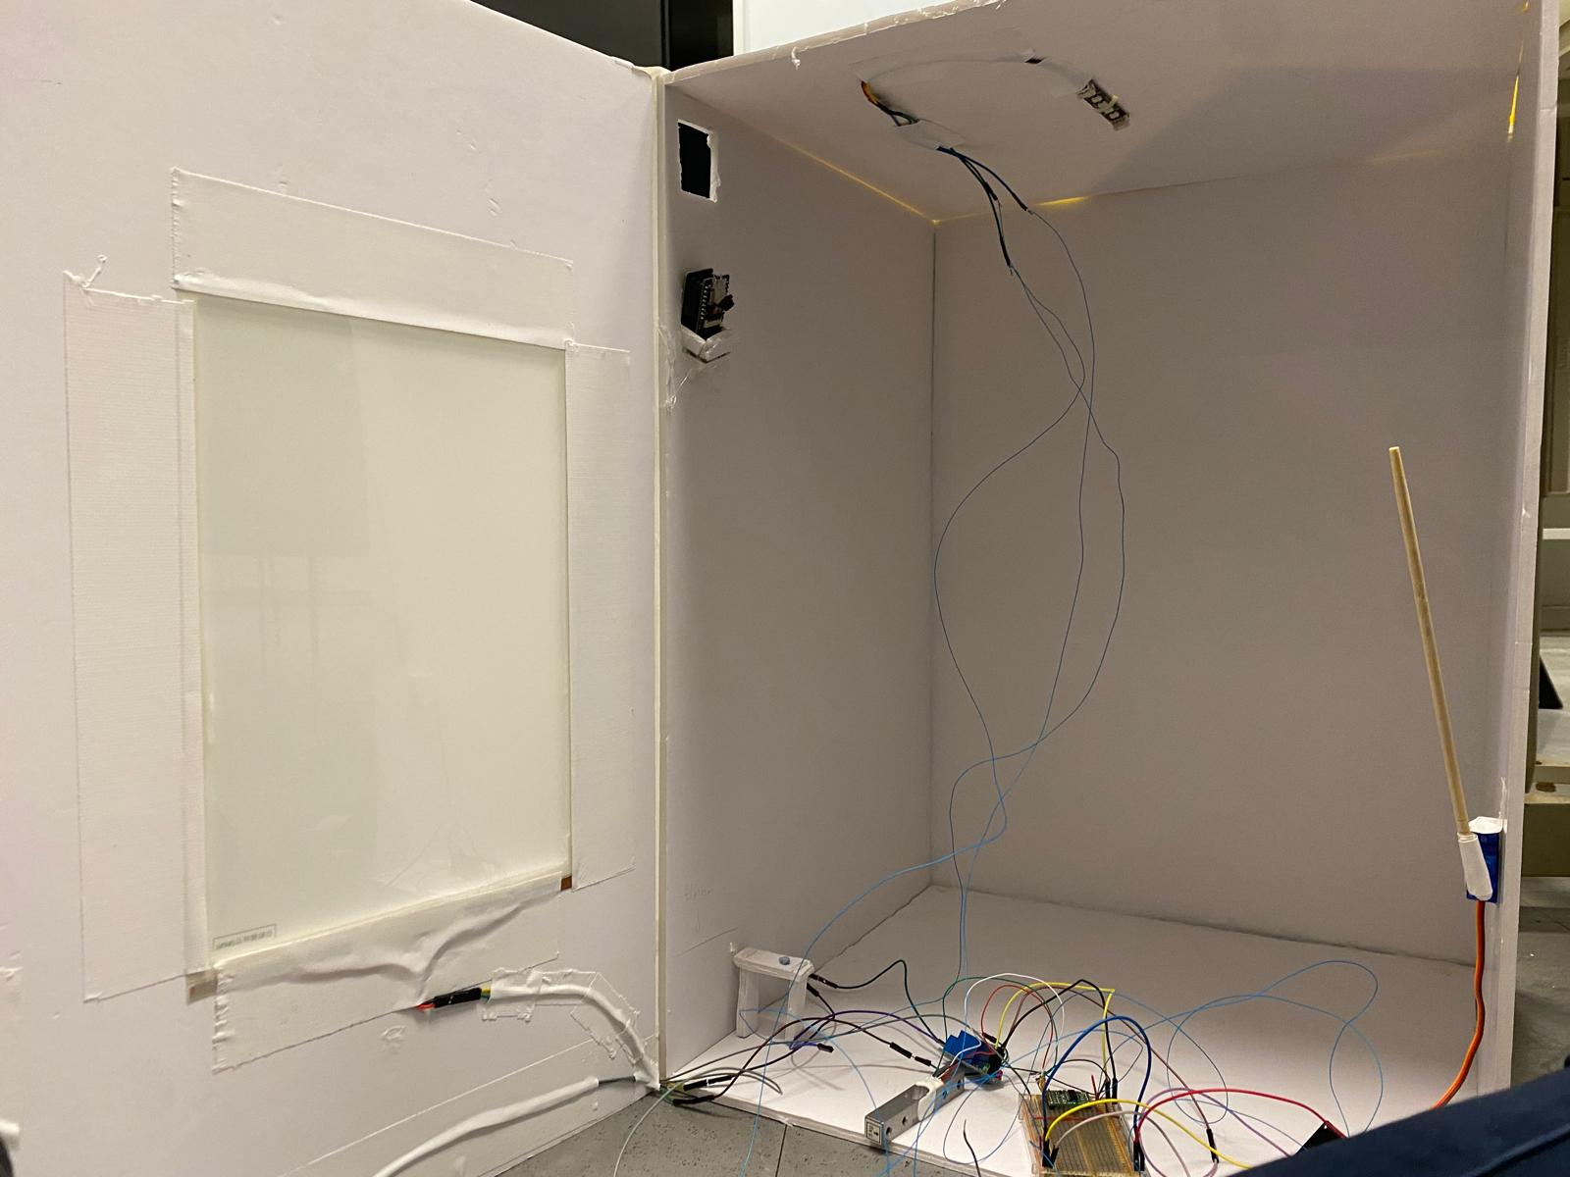
Initial (Cabinet)
Created a mount for the esp32 cam and place it there to take image
Build the box
Connected everything to check if the concept works

Slide 21
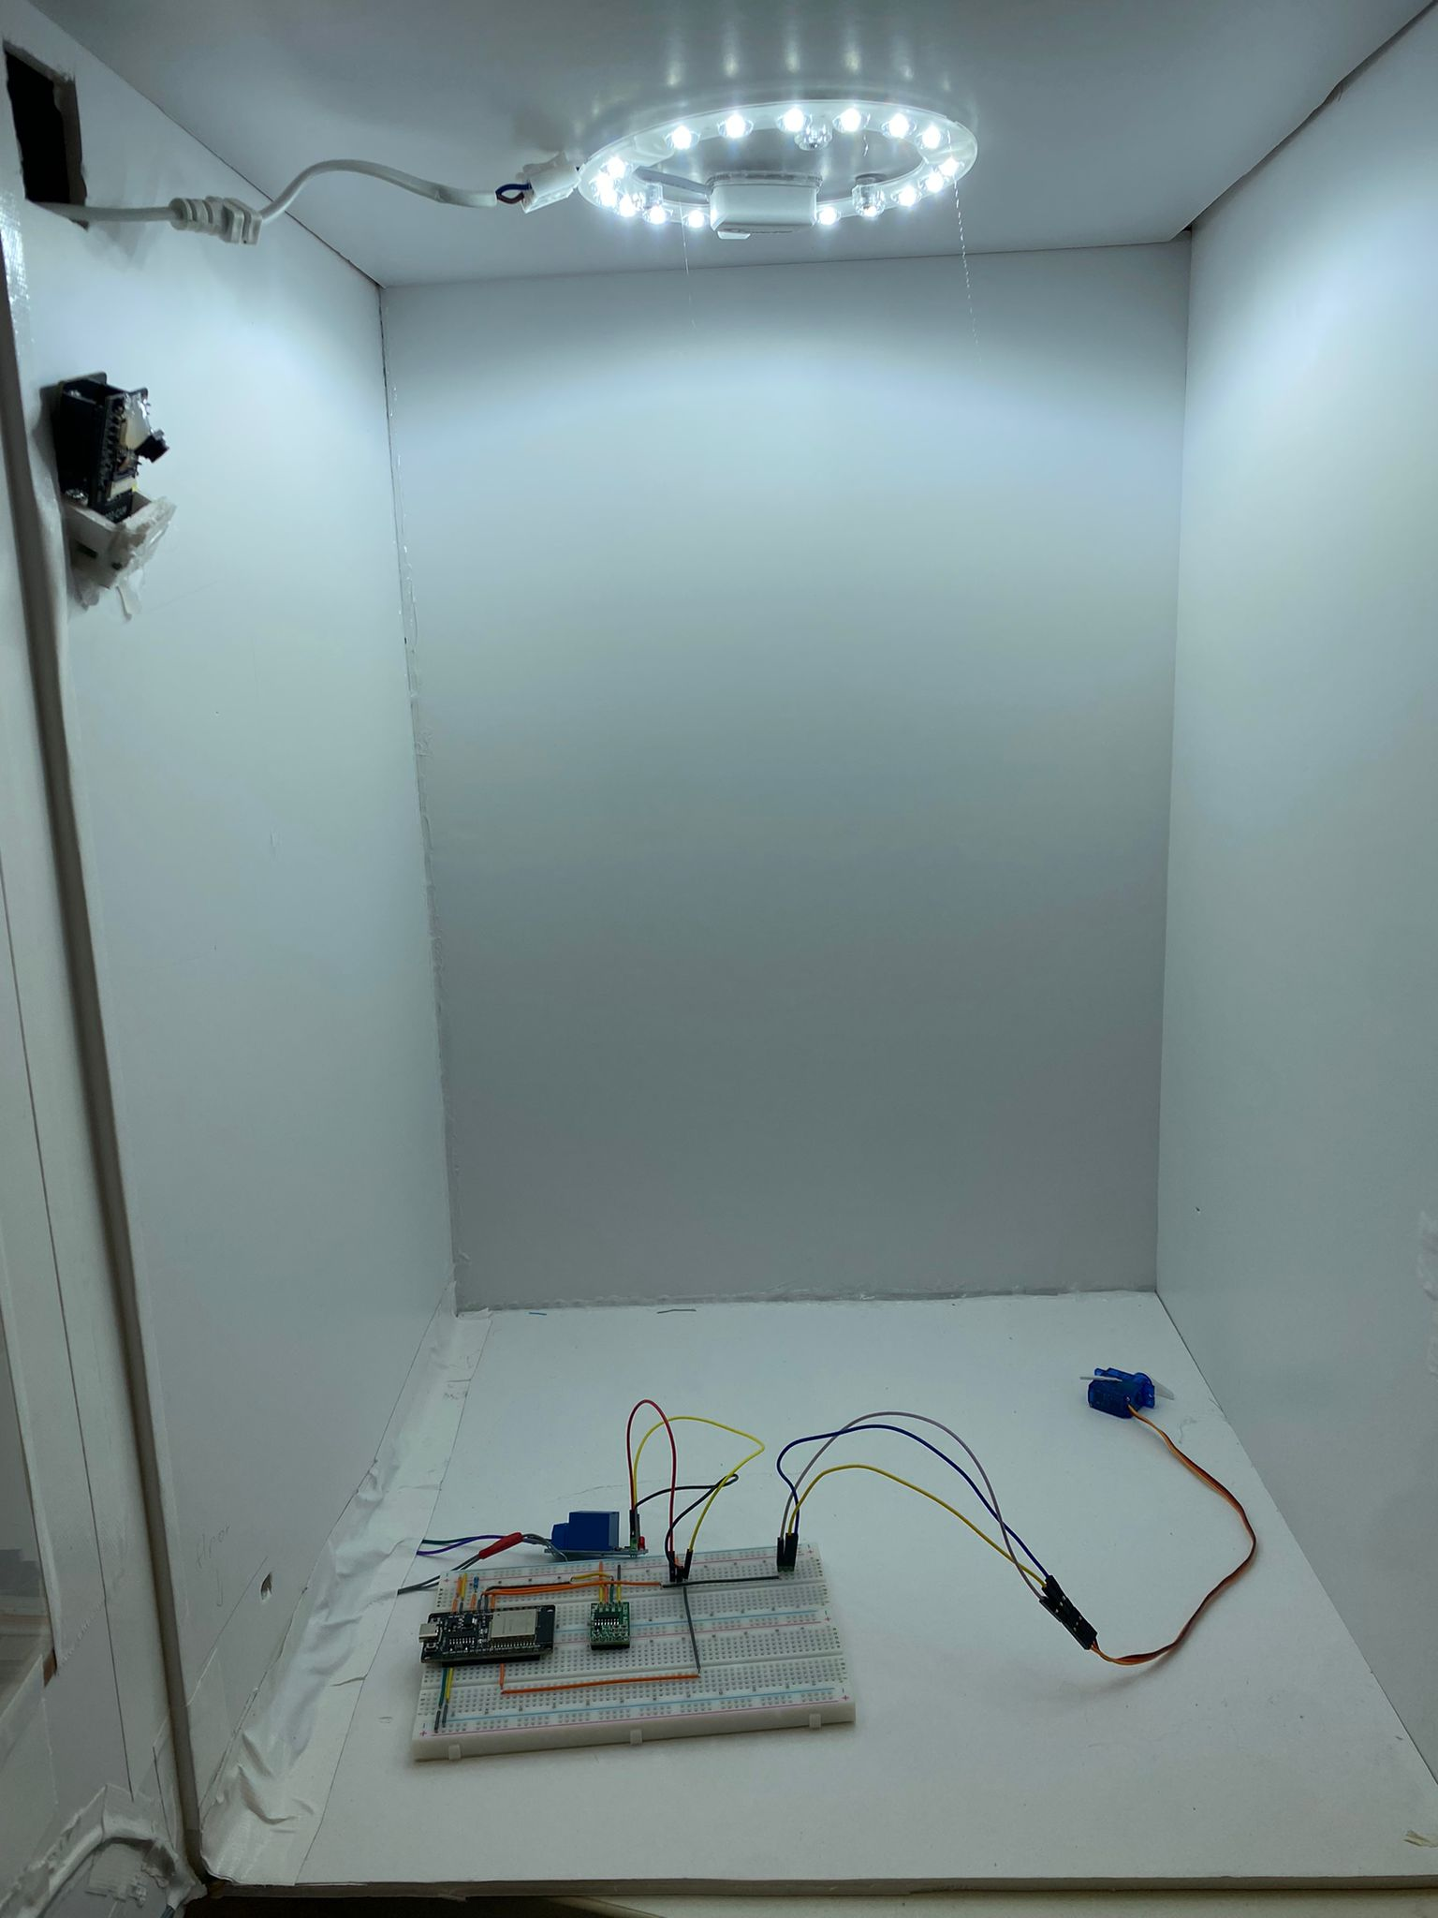
Improved (Cabinet)
We realise insufficient light was hitting the esp32 cam we added a led ceiling ring like to the top.
We mounted the Esp32 cam using hot glue gun after finding the optimal spot for the fov to capture the whole box
We cleaned up the wiring and did a bit of rewiring and cable management

Slide 22
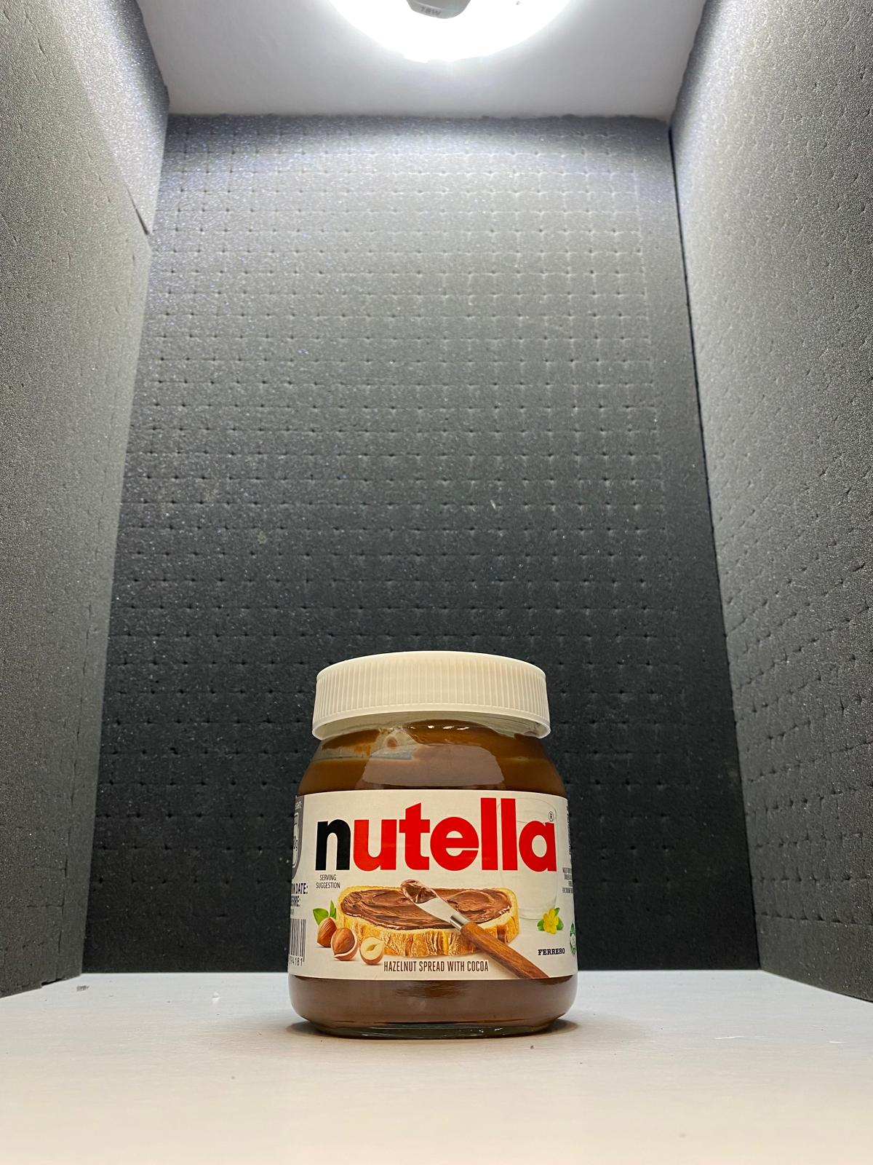
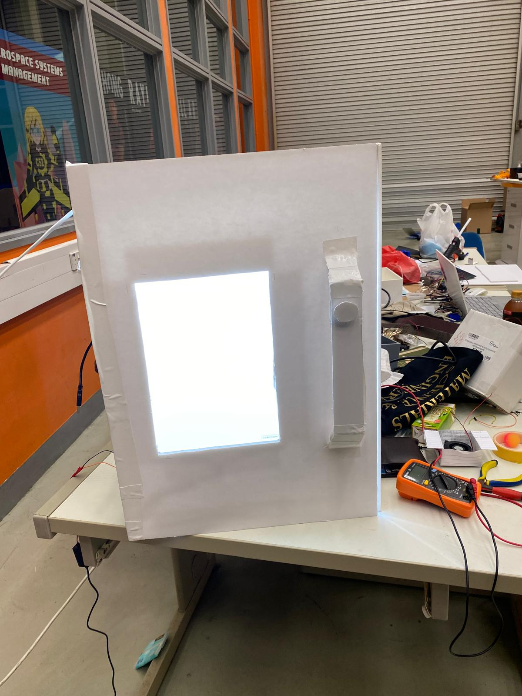
Final (Cabinet)
We added black foam to reduce the amount of light bouncing into the camera causing it the image to be over exposed
Created a base for the box so that the components can be hid under and also to allow the load cell to work better
Internal View
External View

Slide 23
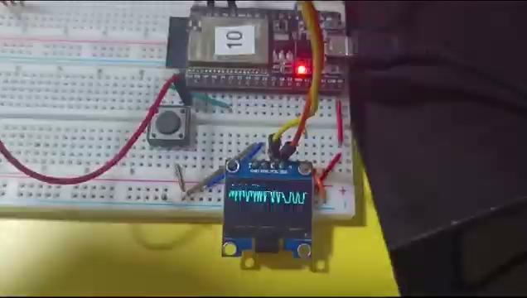
smartwatch
3d model
This shows the UI of the watch at it initial stages
3D model made to fit all the components inside to make it a wearable.

Slide 24
04
Hardware Overview

Slide 25
Smart watch Hardware overview
Ncir sensor
Oled
Pulse sensor
The pulse sensor monitors the heart-rate and biofeedback of the body measuring the change in volume of a blood vessel that occur when the heart pumps blood using an optical sensor and green LED.
The HR data is sent to the watch to be displayed in real time and sent which is also sent to the server
NCIR is a single-point infrared temperature sensor that detects temperature by measuring the infrared radiation emitted with a temperature measurement range of -70°C to +380°C.
The HR data is sent to the watch to be displayed in real time and sent which is also sent to the server
The organic light-emitting diode (OLED) display is a mono color, 0.96-inch display with 128×64 pixels
It is used to display all the health data (Heart rate, body temperature) and other health reports and alerts

Slide 26
Smart watch Hardware overview
Potentiometer
Button
The potentiometer is used to control the smart watch by allowing it to turn the page and showing hovering over the item it wants to select
The button allows the watch to wake and sleep and also works with the potentiometer to select functions in the watch to display such as the heart rate and the health report

Slide 27
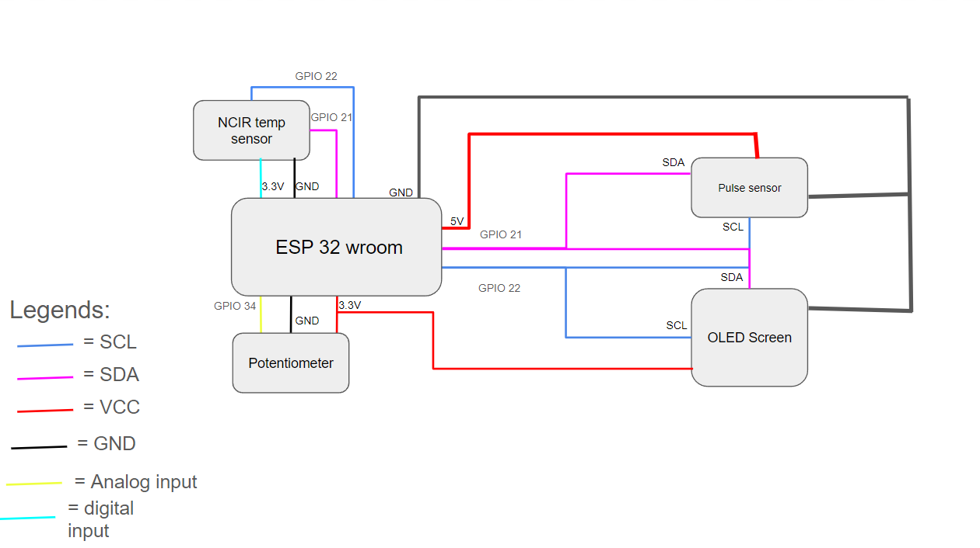

Slide 28
Hardware overview (cabinet)
Relay
Led strip
Esp-32 cam
ESP32-CAM is a low-cost ESP32-based development board with onboard camera, small in size
It is used to take image of the inside of the cabinet to send to the server to run it through its yolo ML model to know the items in the cabinet
The relay is used to turn on the Electrochromic glass in the cabinet so that when the touch sensor is activated it will turn on and let the user look into the cabinet
The Led strip is turn on when activated to increase the brightness in the cabinet so that it would be easier for the esp 32 cam to take photos of the items inside the cabinet

Slide 29
Hardware overview (cabinet)
Button
Electrochromic glass
Servo motor
The servo motor will be used to open the door , when prompt it will open or close the locking mechanism allowing the door to be open.
Toggles the servo motor to open and close the door of the cabinet
Electrochromic glass changes its light transmittance only when triggered by an electrical signal
It turns transparent when activated by the touch sensor

Slide 30
Hardware overview (cabinet)
Load cell / HX711
Capacitive touch
(aluminium foil)
It was self made by us by adding a large piece of aluminium foil where when it is touched it sends a signal to the esp32 to turn the electrochromic glass transparent
The load cell measures mechanical force, mainly the weight of objects. Connected to HX711 a precision 24-bit analog- to-digital converter (ADC). It is used to track the amount of weight of the items in the box to track the amount of food ate by the user

Slide 31
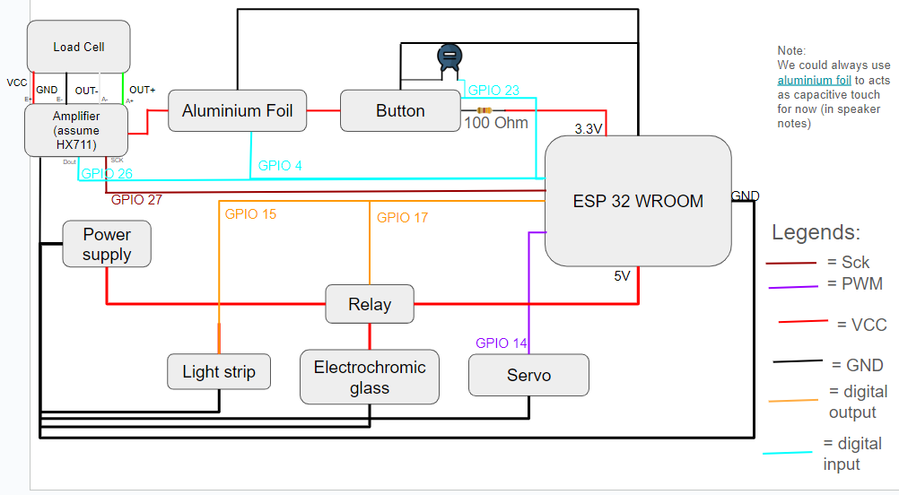

Slide 32
05
Software
Overview

Slide 33
Smart health watch

Slide 34
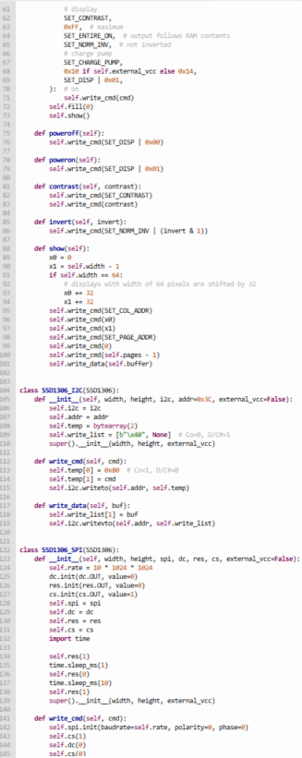
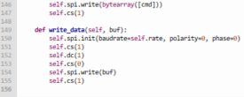
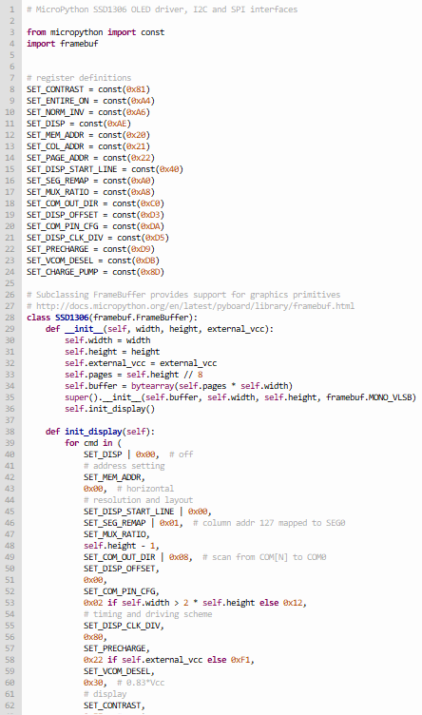
Libraries(OLED)
A module that I imported so i can run my oled display from the main file

Slide 35
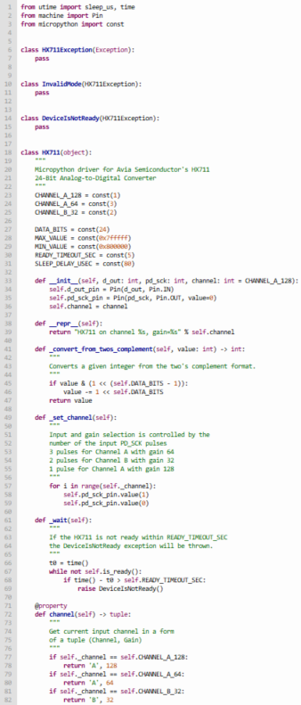
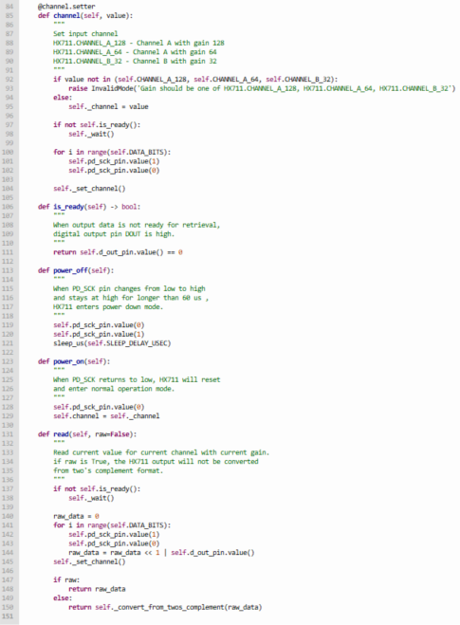
Libraries(HX711)
A module that I imported so i can access the data being sent from the load cell to the HX711 to the main file

Slide 36
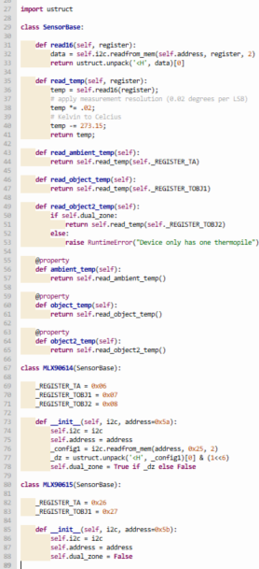
Libraries(NCIR/MLX90614)
A module that I imported so i can access the data being sent by the NCIR sensor from the main file

Slide 37
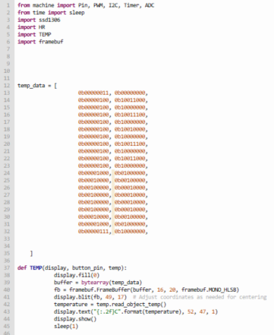
TEMP(Temperature)
Initialization:
Imports libraries.
Sets up pins for button, display communication (likely I2C), etc. (not shown).
Heart Rate:
HR module likely handles pulse sensor reading, peak detection, and BPM calculation (details not shown here).
Temperature:
TEMP module likely reads the temperature sensor.
TEMP function displays a custom temperature icon on the OLED using framebuf.
It then reads the temperature and displays it with two decimal places.
Display Updates:
The code likely calls functions from HR and TEMP to retrieve heart rate and temperature values.
It refreshes the display with the heart rate (potentially using a separate function) and temperature using the TEMP function shown.

Slide 38
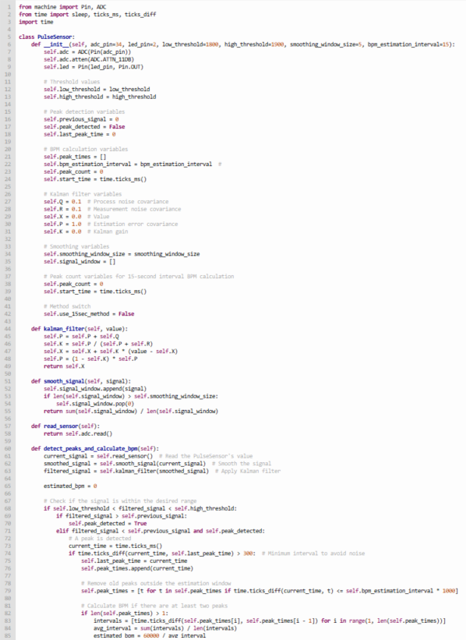
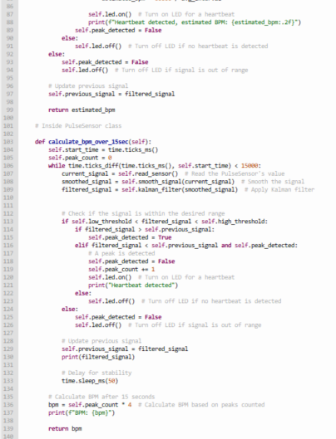
Libraries(Pulse sensor)
This is a Custom made library, made by us to get the data from the pulse sensor and access it from the main file

Slide 39
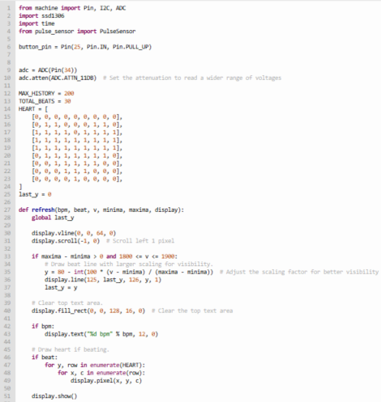
HR (Heart rate)
Pin Configuration:
button_pin: Input pin for the button with pull-up resistor (active when not pressed).
adc: Instance for analog-to-digital conversion (reading sensor voltage).
adc.atten(ADC.ATTN_11DB): Adjusts voltage reading range for better sensor compatibility.
Constants:
MAX_HISTORY: Maximum number of recent sensor readings to store (e.g., 200).
TOTAL_BEATS: Maximum number of recent heartbeats to track (e.g., 30).
Heartbeat Visualization (HEART):
Predefined pattern representing a heartbeat displayed on the screen.
refresh Function (Display Update):
Clears the display area and scrolls content left for animation.
Heartbeat Line (if detected):
Calculates a scaled position based on voltage for visualization.
Draws a line representing the heartbeat.
Heart Rate Text: Displays calculated heart rate if available.
Heartbeat Animation (if detected):
Iterates through the HEART pattern to draw pixels and create the animation.
Updates the display with all drawn elements.

Slide 40
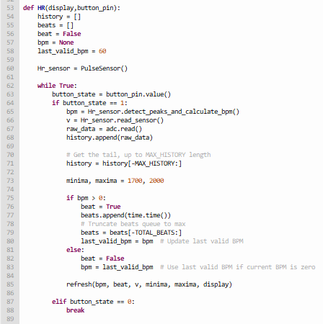
HR (Heart rate)
The code is designed to measure and display heart rate using a pulse sensor.
Here's how it works:
Data Collection: It continuously reads data from the pulse sensor and stores recent readings.
Heartbeat Detection: It analyzes the sensor data to identify peaks, which represent heartbeats.
Heart Rate Calculation: It calculates the heart rate based on the time between detected heartbeats.
Display Update: It displays the calculated heart rate and other relevant information on a connected display.
Button Control: The code waits for a button press to start or stop the heart rate measurement.

Slide 41
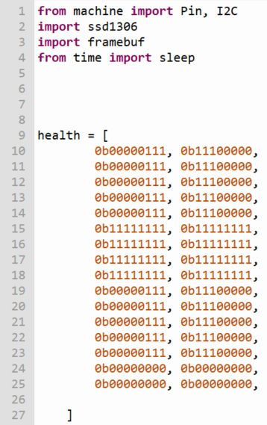
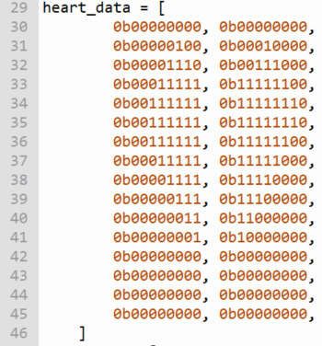
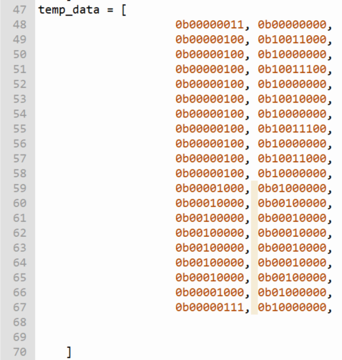
Page_1 (Homepage design)
This are the designs for the heart, thermometer, and health report

Slide 42
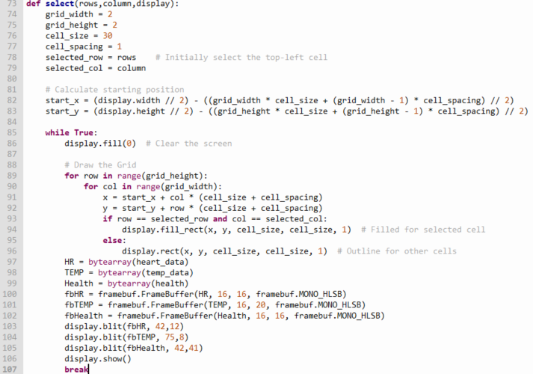
Page_1 (Homepage design)
Functionality: Presents a grid layout on the OLED display and allows selection of a cell using button presses (button handling likely not shown).
Grid Parameters:
Number of rows and columns (rows, column - likely received as arguments)
Cell size (cell_size)
Spacing between cells (cell_spacing)
Display Update Loop:
Clears the screen.
Draws the grid:
Iterates through rows and columns.
Calculates the position of each cell based on screen size and grid parameters.
Draws a filled rectangle for the currently selected cell.
Otherwise, draws an outline for other cells.
Displays health icons (assuming heart_data, temp_data, and health are predefined byte arrays representing icon data):
Converts each bytearray to a framebuf.FrameBuffer object for efficient display.
"Blitz" (draws) each icon buffer onto the OLED display at specific coordinates.
Shows the updated display.

Slide 43
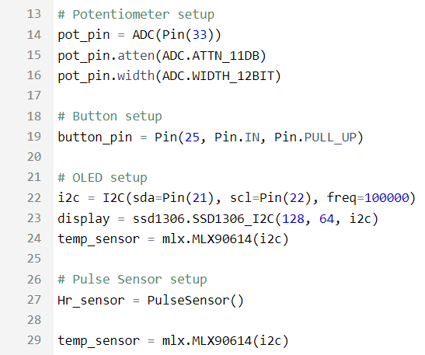
Main code (Initialisation/setup)
Potentiometer:
Creates an ADC object (pot_pin) for reading analog values from pin 33.
Sets the voltage attenuation to 11dB (ADC.ATTN_11DB) for better resolution at lower voltages.
Sets the analog-to-digital conversion width to 12 bits (ADC.WIDTH_12BIT) for higher precision.
Button:
Creates a Pin object (button_pin) for reading button state from pin 25.
Sets the pin mode to input (Pin.IN) and enables a pull-up resistor (Pin.PULL_UP) to ensure a high default state.
OLED:
Creates an I2C object (i2c) for communicating with the OLED display.
Creates an SSD1306 object (display) to control the OLED display with a resolution of 128x64 pixels.
Creates an MLX90614 object (temp_sensor) for reading temperature using the MLX90614 sensor.
Pulse Sensor:
Creates a PulseSensor object (Hr_sensor) for measuring heart rate from the pulse sensor (implementation details might vary depending on the library).

Slide 44
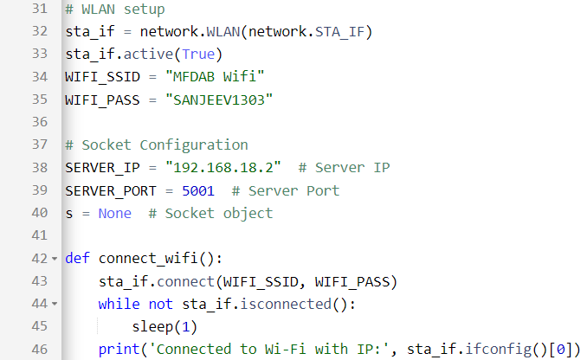
Main code (WifiConect module)
This function establishes a Wi-Fi connection to the specified network.
WLAN setup would activate the Wi-Fi interface (sta_if) and set the SSID and password for connection.
Socket Configuration initializes variables for the server IP address, server port, and the socket object (s) which starts as None (not yet connected).
Connects to the Wi-Fi network: Uses the sta_if.connect() method to initiate the connection using the provided SSID and password.
Waits for connection: Continuously checks if the connection is established using sta_if.isconnected(). If not, it waits for 1 second before checking again.
Prints connection status: Once connected, it prints the device's IP address to the console for confirmation.

Slide 45
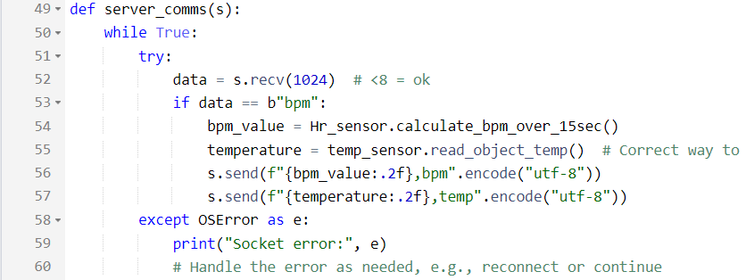
Main code (Server Communications)
This function handles communication with the server.
Continuous loop: Runs indefinitely to maintain a connection.
Receives data: Attempts to receive data from the server using s.recv(1024).
Checks for "bpm" command: If the received data is "bpm", it calculates the heart rate and temperature.
Sends data to server: Sends the calculated heart rate and temperature values to the server in a specific format.
Error handling: If a socket error occurs, it prints an error message and likely handles the error (e.g., reconnecting).

Slide 46
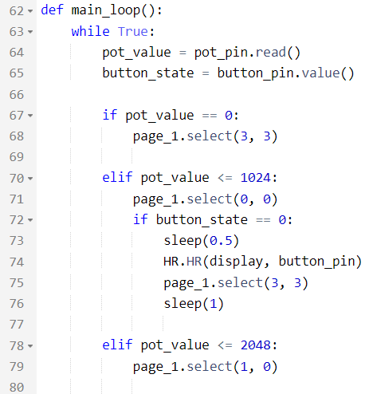
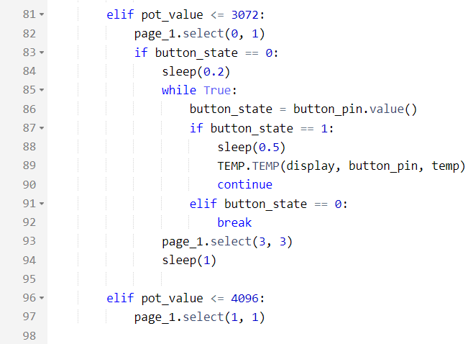
Main code (Main loop)
This function is the main program loop that controls the device's behavior.
Continuous loop: Runs indefinitely to keep the program running.
Reads potentiometer and button values: Reads the current values from the potentiometer and button.
Handles potentiometer value ranges: Based on the potentiometer value, it selects what information should be displayed on the OLED.
Button handling: If the button is pressed, it performs specific actions like starting heart rate measurement or displaying temperature.

Slide 47
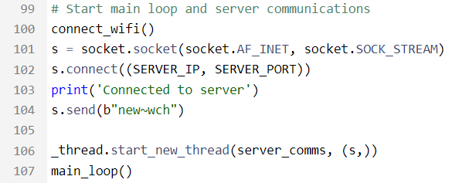
Main code (Main Program)
Establishes Wi-Fi connection.
Creates a TCP socket for server communication.
Connects to the specified server.
Sends an initial message to the server.
Starts a new thread to handle server communication.
Initiates the main program loop.

Slide 48
Cabinet

Slide 49
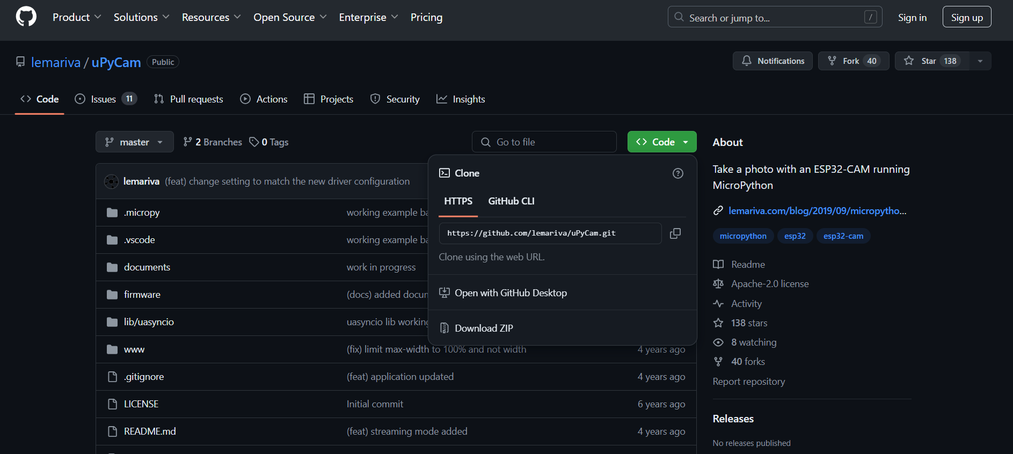
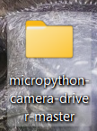
How to install Lemivara’s firmware for esp32 cam (option 1)
Download the whole code
Unzip the folder

Slide 50
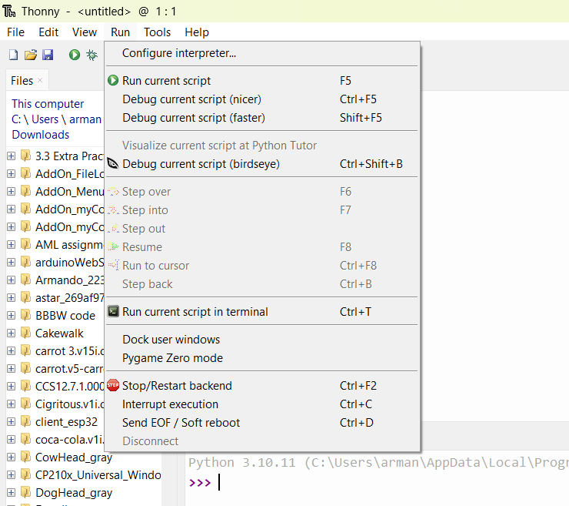
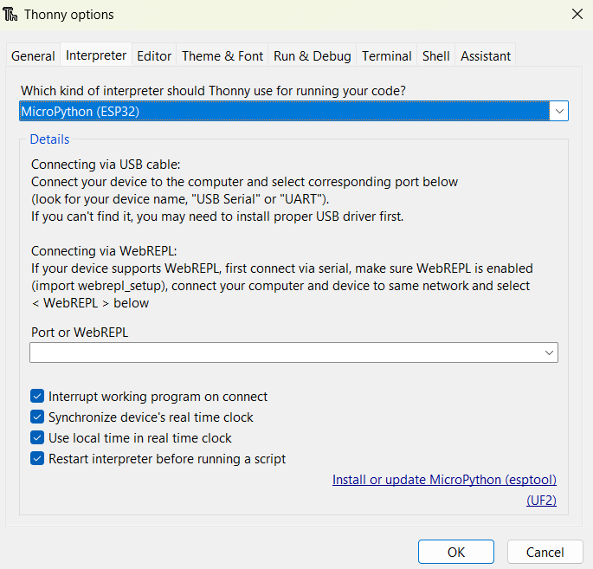
How to install Lemivara’s firmware for esp32 cam (option 1)
Go to “Run” -> “Configure Interpreter..”
Select “Micropython (ESP32)” (green)
and follow below

Slide 51
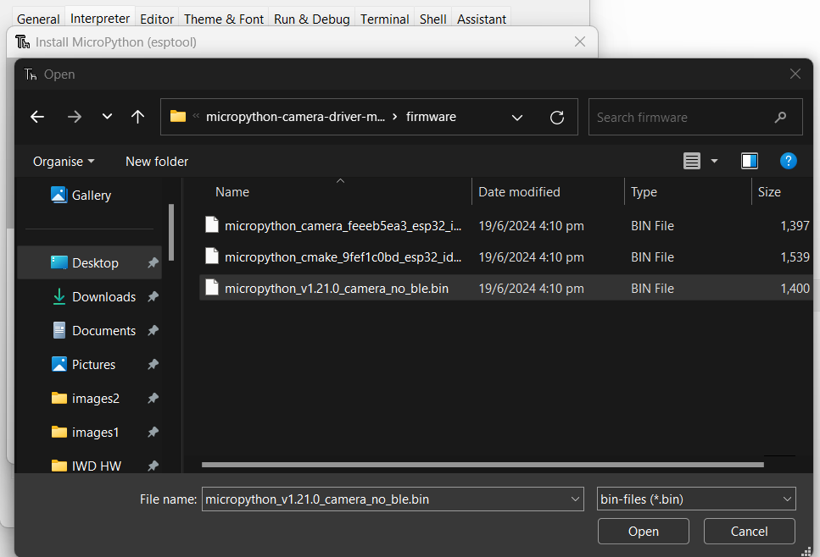
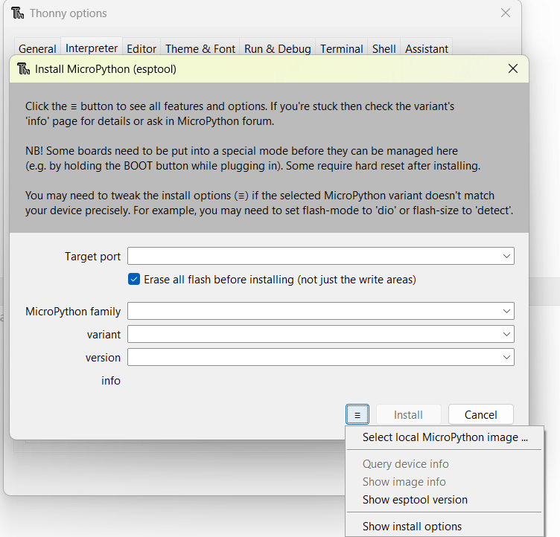
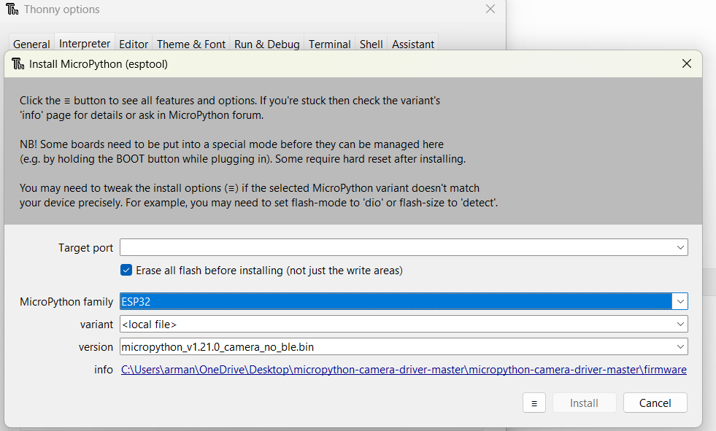
How to install Lemivara’s firmware for esp32 cam (option 1)
Find the file under “firmware”
Find the icon and follow below
Note:
Some people could use the firmware with the “_cmake_”. However, I only was successful in using the “camera_no_ble”
Press install
To check if your firmware is working check it with your serial monitor
any will do: Arduino IDE(assuming you have download the esp32 board driver before) , Thonny or even putty (if you can configure)

Slide 52
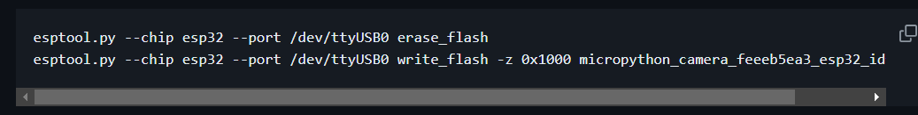
How to install Lemivara’s firmware for esp32 cam (option 2)
Note: if this code run on your command prompt and gives you an error, you could always remove the “--port /dev/ttyUSB0” or “--port COM7”
To check if your firmware is working check it with your serial monitor
any will do: Arduino IDE(assuming you have download the esp32 board driver before) , Thonny or even putty (if you can configure)

Slide 53
Context
Server always prompt the cabinet to do a task. The response to this could be:
Gather and send sensor information
E.g. Request for ESP32 Cam to take pictures
Sequence of events:
Server
Send request
ESP32 CAM
Send photo
(in bytes)
Server
Actuate an actuator
E.g. Turns off the LED strips
Sequence of events:
Server
Send request
ESP32 Wroom
Turn off LED
LED strip
All devices here will follow the convention 1 of sending info from ESP32 to server

Slide 54
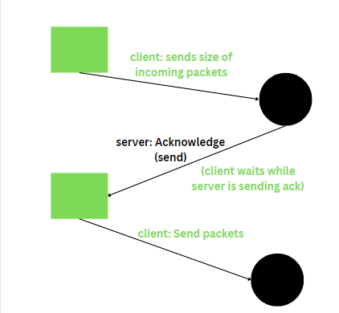
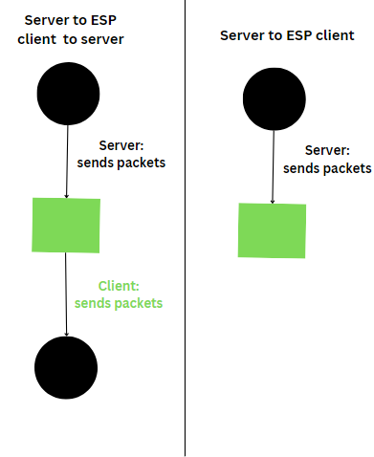
Sending info using sockets
Convention 1
Convention 2
Before sending message:
Send the size of the message to be sent
After acknowledgement for size declaration:
Send the message to receiver
Send the information from the transmitter to receiver
In the cabinet’s case usually information are 4 characters long
Only seen by Client to server (more details in assignment)
Only using the server to ESP client (more details in assignment)

Slide 55
Control Flow:
Legends:
Saves weight (before opening)
Esp32 wroom
Server
Esp32 Cam
= Next step
Message received
= Convention 2
Start
Button is pressed
Check weight
Send weight
Unlocks cabinet door
= Convention 1
Note: The arrows pointing up means that they do not contribute to the flow. As in if you were to remove them from the control flow can still go on.
Also this is a simplified version.
(User uses the cabinet)
Saves weight (after opening)
Button is pressed
Locks the cabinet door
Open the LED strip’s lights
Check weight
Send weight
Message received
Sends request for ESP32 CAM for picture
Show predicted items and picture in web server and save data
Predict items in picture
Message received
Close LED strip’s lights
Message received
Send request to close LED strip’s lights
Saves and decode picture
Message received
Send picture
Takes a picture and de-initialise camera
Initialise camera

Slide 56
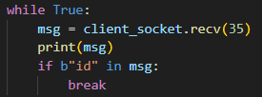
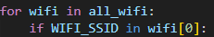
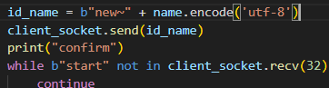
ESP32 CAM on Start
Initialise socket
Initialise Wifi
Make WLAN network interface that connects to Wifi’s Access points and activate the station interface
Makes a socket object with the address family of AF_INET and of SOCK_STREAM socket type. Then connect to server
Scans for all available access points
Wait for server to recognise that a client has been connected.
Over here the client waits for the request for id from server
Repeat until we are connected
Check if from all the access points they have the same ssid as the one we want to connect
Connect to the wifi’s access point of the SSID we specified
Sends the id it wants to be called on in the server side.
Then wait until the server finishes registering the client
More can be seen in the assignment
Ensure that we will always connect to wifi if the access point is available

Slide 57
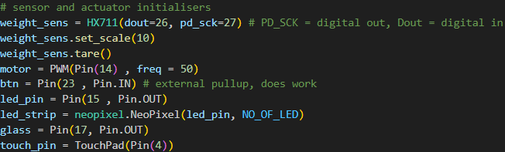
ESP32 Wroom on Start
Start
Initialise the pins according to the diagram
Initialise the weight sensor readings
On start, weigh the cabinet when its empty(128g) and when it has a predetermined weight(481g)
It reads the load cell for 50 times and give you the average of the weight
Assuming the weight and load cell readings are linearly proportional
Find the gradient and y-intercept
Similarly to ESP32 CAM, initialise for socket and wifi

Slide 58

Button is pressed
Button is pressed
I set it as falling so even if you hold the button there will only be counted as 1
Also, for Ux it feels better to press and immediately get to see results
Instead of lifting your finger from the button
For debounce and resistance against noise coupling
{
{
Acts as flags for the conditions in the main code

Slide 59




Check weight
*reads 50 times of the load cell and finds the average
Send weight
Convention 1
Saves weight (before opening)
Unlocks cabinet door

Slide 60

Locks the cabinet door
Open the LED strip’s lights
Sets all LEDs to (r = 255,g = 255,b = 255)
Check weight
*reads 50 times of the load cell and finds the average
Send weight
Convention 1
Sends request for ESP32 CAM for picture
This is done so that nothing can be changed before I read and take the picture

Slide 61





Sends request for ESP32 CAM for picture
Convention 2
Finds all the clients known id called img
Saves weight (after opening)
Initialise camera
Takes a picture and de-initialise camera
I used finally in try and except because in any case it will always deinit the camera
Send picture

Slide 62


Saves and decode picture
We decided to overwrite our pictures after every receive
Send request to close LED strip’s lights
Convention 2
Finds all the clients known id called img
Close LED strip’s lights
Sets all LEDs to (r = 255,g = 255,b = 255)

Slide 63


Predict items in picture
Create Yolo object
For items that are predicted as x item for 60% or more confidence are outputted.
The image size allowed is only 640.
The images will then be annotated and saved in a runs/detect/predict_
Where _ is the amount of folders of predict there are
e.g. under runs/detect/
predict
predict2
predict3
Get Each item’s boxes object.
Find its classification and put it into a list from the boxes object
I set it as:
0: nutella
1: pepsi
2: pringles
As yolo’s convention for labelling is numbers
Show predicted items and picture in web server and save data
Make all items into the Item object
Add the items predicted into the “Item” table
Save changes

Slide 64



Show predicted items and picture in web server and save data
To show image on the webpage
Update the items in the html using jinja
Query the whole Item table and put it into jinja’s arguments
Loops through all the items and find its item name and quantity

Slide 65
Dashboard/Website

Slide 66


LOGIN PAGE

Slide 67


Slide 68

Home page
This is the main page where it links to the the Health monitor, Cabinet, Health Report and Habit tracker to get more info on each category
Habit Tracker
Health Report
Cabinet
Health monitoring
The habit tracker analyses and track the nutrients you have eaten based on the data from the cabinet and the smart watch
The health report helps you view your health report from the hospital and allows you to send health comments to the doctor
The Cabinet allows you to view the items in the cabinet via your phone such that it would allow easier logistics as you do not need to remember the items in the cabinet
The Health monitoring helps track the smart watch users health data like heart rate, blood glucose,blood oxygen meter, and body temperature in real time and also within a range of a week

Slide 69




Health Monitoring page
Tracks the real time health data and updates the round progress bar around the icons to show a sense of healthiness which is based on a range for a healthy person

Slide 70



Health Monitoring data
Displayed health data from over the past 7 days (week ) so that it is easier to detect any abnormalities in the health data.

Slide 71

Cabinet
Displayed a the latest photo of inside the cabinet from the last time the cabinet was open

Slide 72

Health Report
helps you view your health report from the hospital and allows you to send health comments to the doctor

Slide 73

Health Report viewer
This page shows your health report stats all your medical report details and the comments and suggestions from the doctor to improve your daily lifestyle habits

Slide 74

Share with doctor
Allows the user to comment on their health so that the doctor can read it and get a better understanding on the patient and diagnose them better

Slide 75
Doctor’s note
Allows the users to view comments and suggestions from the doctor to improve your daily lifestyle habits

Slide 76

Health Tracker data
Displays the macro nutrients that the user has intake and loss based on the cabinet and smart watch.

Slide 77





Health Tracker data
Displayed health data from over the past 7 days (week ) so that it is easier to detect any abnormalities in the health data.

Slide 78
07
Problem & Solution

Slide 79




Problem & solution (Hardware)
Problem | Solution
ESP32 Cam rarely is able to take good quality photos for the ML model to predict | Don’t use the camera for more than 1 hour If the camera starts to give error photos press the “RST” or unplug and plug
RST
Error photos
Good photo

Slide 80
Problem & solution (Hardware)
Problem | Solution
The connectors keeps coming loose and loosing connection for the electrochromic glass | We decided to wire wrap the connection cables
Pins of the esp32 causes noise coupling and causes abnormal data readings for the button | We added capacitors to the button’s pin to the ground to reduce the noise and change the location as far from other pins

Slide 81


Problem & solution (Hardware)
Problem | Solution
Did not know the voltage needed to supply the electrochromic glass. (The manufacturer did not give any datasheet) | Soldered two pieces of wires to be able to measure the voltage in parallel. Then Connect these wires to the jumper and connector
Laptop

Slide 82
Problem & solution (Hardware)
Problem | Solution
Electrochromic glass requires high voltage (around 20 - 34V) and low current | Used the USB connector(that has a transformer) and connect it via a relay to supply or leave the electrochromic glass open
Lack of brightness for the camera | We experimented with led strips, UV light strips and in the end we used a ceiling light with around 30k lumens
The box was to bright after light addition and the white colour was reflecting the light causing the image to be over exposed | We added black foam to the sides to reduce the amount of light bouncing.

Slide 83
Problem & solution (Software)
Problem | Solution
There was no readily available library for the pulse sensor | We had to create a custom library to run the pulse sensor
The Pulse sensor data being received was to noisy and unreadable | We added a Kalman filter to reduce the amount of noise
Having 2 threads that receive sockets. This makes the order of where the message gets received is ambiguous | Put all the receive into 1 socket receive

Slide 84
Problem & solution (Software)
Problem | Solution
The button was unreliable due to bouncing | Added a debouncing code and extra delay due to the electrochromic glass
The frame buffer will never stay constant because there are many users sending info to the server | The ESP32 clients usually declare their size of message before sending and if any messages are received before then, they will use the largest frame buffer Hence,the frame buffer will always be bigger than any message
It is hard to identify and call the whole remote address to send info to a esp32 client | Associate the given id(from the esp client on start) with its remote address on the server. So it is easier for the programmer to send info to a client.

Slide 85
Problem & solution (Software)
Problem | Solution
For the CV training, the pictures were taken from many sources. Hence, relabeling and splitting of images is required | I made a script to rename all the labels of nutella(as it had a different label to the other dataset I have) and split the images into training, testing and validation
The model was not able to predict properly predict | Added some extra pictures taken from the esp32 cam as training,testing and validation dataset

Slide 86



Problem & solution (Software)
Problem | Solution
Serial monitor of Thonny was not working For Esp32 Cam | Set the following parameters for configuration.ini
Configuration.ini

Slide 87
Problem & solution (Website & server)
Problem | Solution
Adafruit is very restrictive in the amount of features able to add and not enough feature | We decided to create our own website and Server to communicate between the esp32’s and website using knowledge of html, css, js & python

Slide 88
08
Reference & Conclusion

Slide 89

References
https://youtu.be/8A4dqoGL62E?si=o7QooOgwWbd1o6Av
https://youtu.be/436VDF-rk4w?si=HLJeLFKR8mP-bj8Y
https://youtu.be/Kg-sxVmCt5Q?si=pJ8aw7vPxOXJIFL6
https://youtu.be/xZF6zWLz-vY?si=vn6EXkiPK49Wyo5H
https://youtu.be/TDgM8eMTpIw?si=Jgo6hKibeRnFMYET
https://lastminuteengineers.com/pulse-sensor-arduino-tutorial/
https://randomnerdtutorials.com/esp32-touch-pins-arduino-ide/
Troubleshooting:
https://github.com/thonny/thonny/issues/2845
https://blog.csdn.net/zhusongziye/article/details/128176230
https://github.com/thonny/thonny/issues/2282
Documentation ,libraries and firmware
https://github.com/lemariva/micropython-camera-driver
https://docs.python.org/3/library/socket.html
https://docs.ultralytics.com/models/yolov9/#usage-examples
https://docs.micropython.org/en/latest/index.html
Dataset:
https://drive.google.com/drive/folders/1Y50k5xA9a6E_1hBGsiXxJK3iCsmsFKud?usp=sharing

